Slide 1
Given At: ArchConf2019

Slide 2
Avoiding Lock-In

Slide 3
Previous
Version
Specific
Framework
Custom
Fork
Our own
code

Slide 4
Previous
Version
I’m on v.4.5 but I want to upgrade to the latest 8.9

Slide 5
Specific
Framework
I’m websphere but I want to be on micronaut

Slide 6
Custom
Fork
We made a customization of hybris and now I can’t merge the latest fixes

Slide 7
Our own
code
I hate the Core_Heat system. We should rewrite that.
Well, we built our own database in the 90’s and …

Slide 8
Previous
Version
Specific
Framework
Custom
Fork
Our own
code

Slide 9
V3.01
v8.4.3

Slide 10
V3.01
v8.4.3

Slide 11
V3.01
v8.4.3

Slide 12

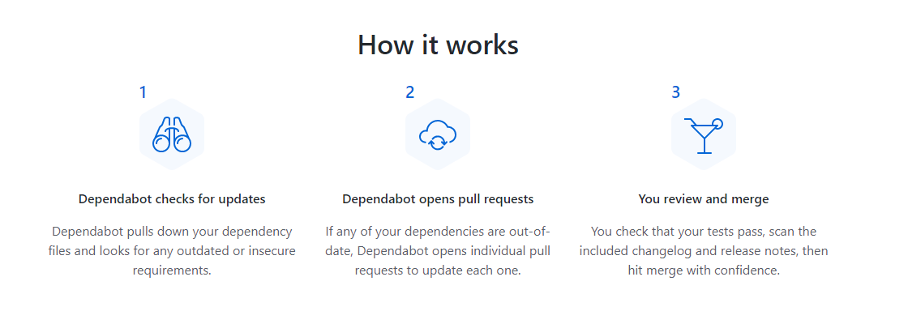
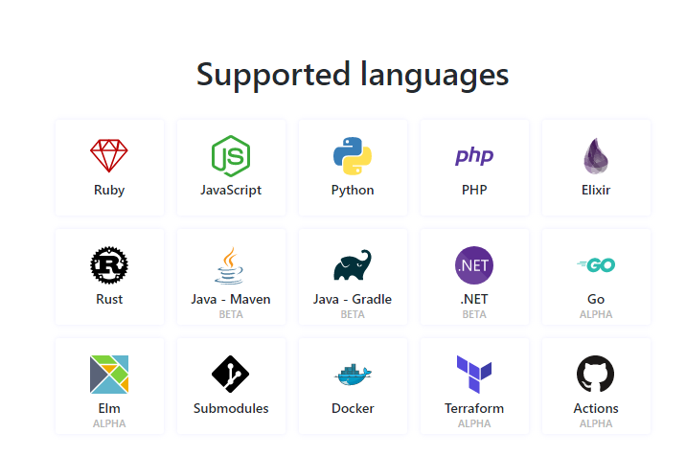

Slide 14
V3.01
v8.4.3

Slide 15
CI

Slide 16
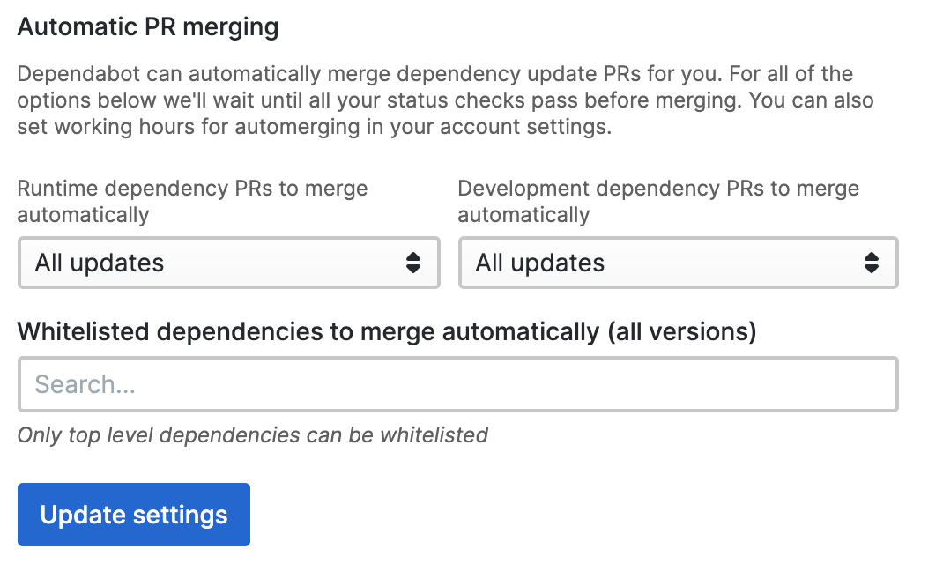

Slide 17
V3.01
v8.4.3

Slide 18
PART I

Slide 19
Stories of the Stupid

Slide 20
git clone https://chromium.googlesource.com/chromium/src

Slide 21
FORK

Slide 22
6.7 million lines of code
150 are yours

Slide 23
0 ☛ Legacy

Slide 24
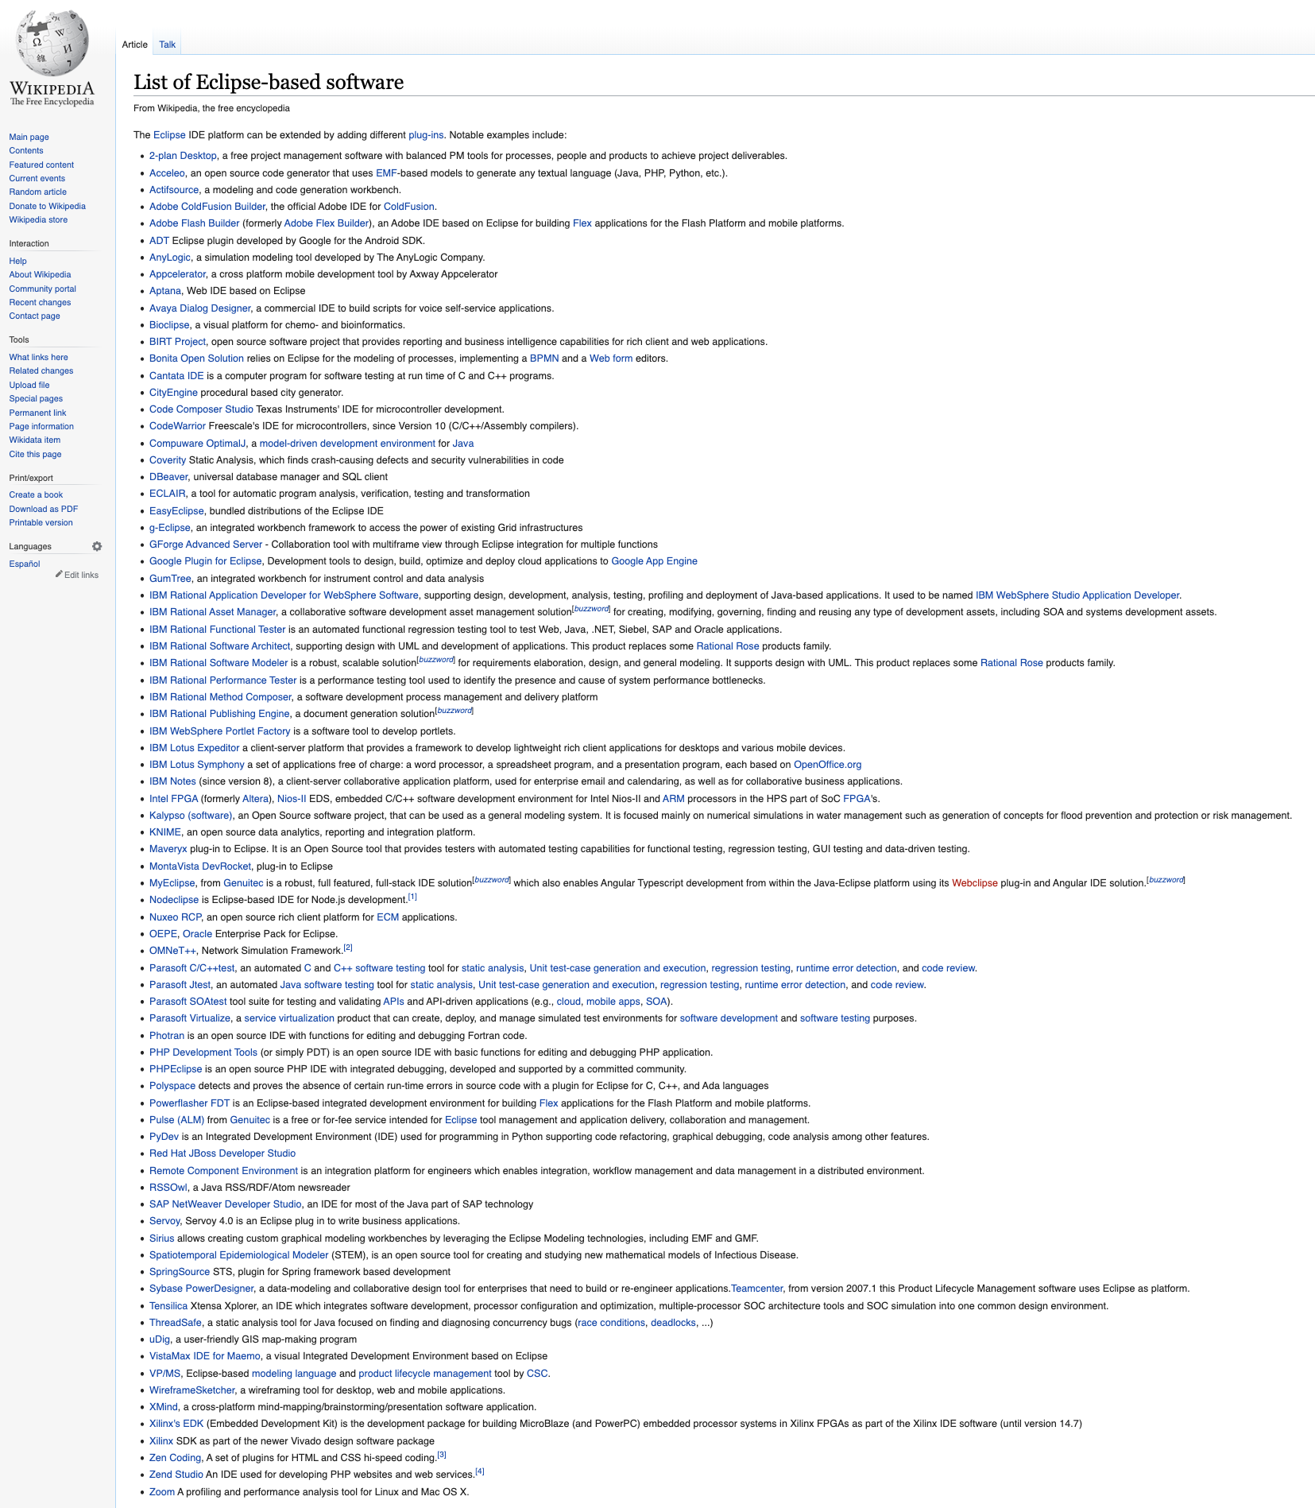


Slide 25
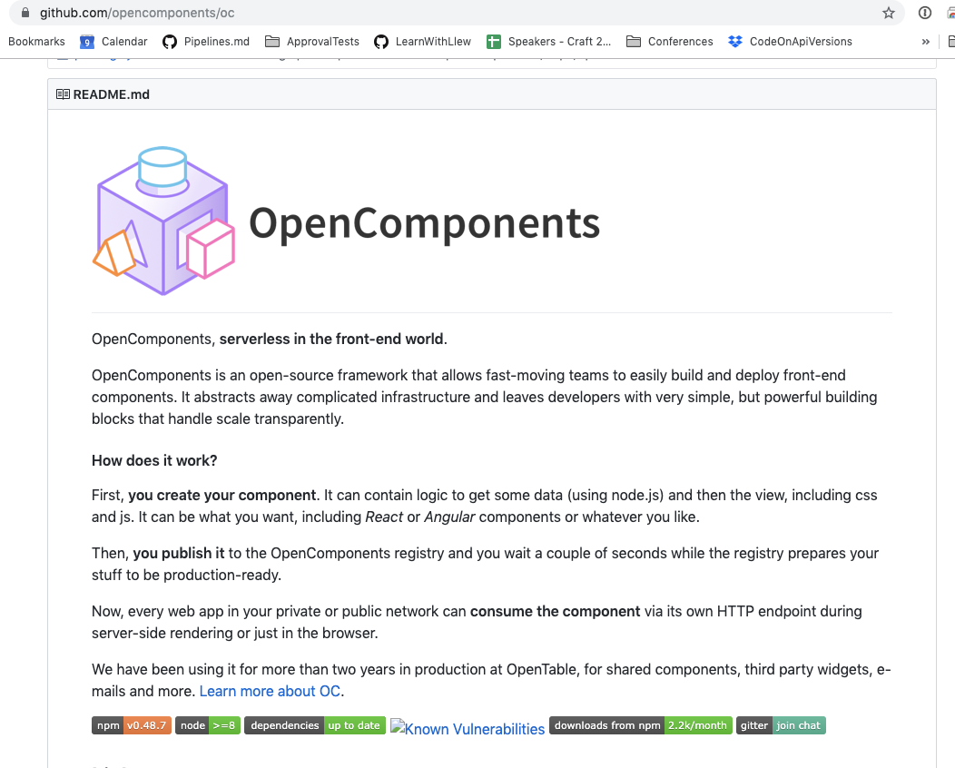
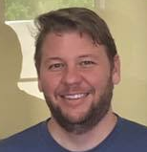

Ken Crawford
Notes:
Open components - aws -> google -> made it extendable -> became a maintainer -> met

Slide 26
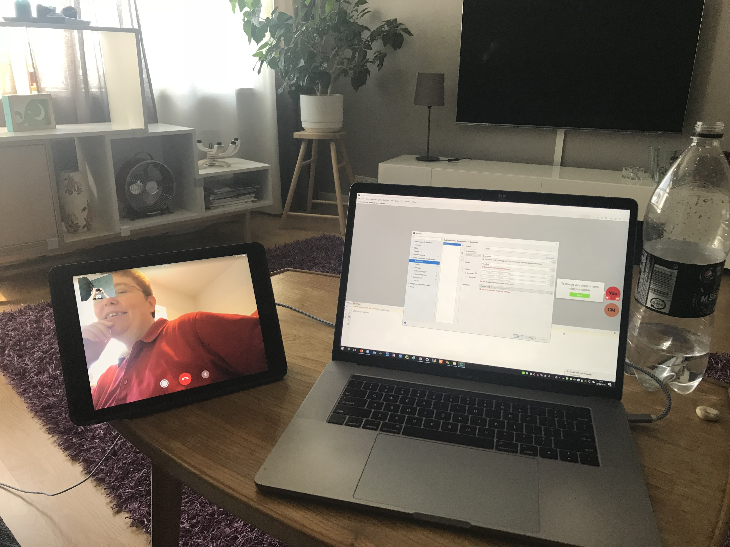
Tips
Pair
https://www.greaterthancode.com/pairing-and-sharing

Slide 27
Tips
Pay

Slide 28
PART II

Slide 29
Framework
Business Logic
Services

Slide 30
Framework
Business Logic
Services

Slide 31
2.
Parameter extraction

Slide 32
2.
Loader & Saver

Slide 33
2.
POJO

Slide 36

Thanks!
Please connect on
LinkedIn & Twitter
@LlewellynFalco
llewellynfalco.blogspot.com
Presentation template by SlidesCarnival

Slide 37
SlidesCarnival icons are editable shapes.
This means that you can:
Resize them without losing quality.
Change line color, width and style.
Isn’t that nice? :)
Examples:

